Slide 1
Computer Science Orientation 2012

Slide 2

The Computer Science
1st Year
Student Academic Orientation

Slide 3
Event Goals
Introduction to the program and department
Setting your “Academic Compass”
Student networking

Slide 4
Welcome
Program introduction
  Chair
  Program Director
  Co-op Coordinator
Location
Our Administrative roles for students
Staff introduction
  staff (CS office)
  Staff (System Admins)

Slide 5
Academic Matters: transition to University
"Toto, I've a feeling we're not in Kansas anymore… "
Managing course load
  Full-time student: what does that mean
  Effective solo studying
  Academic Integrity
Academic Standings
  Clear
  Probationary
  RTW
  PPW

Slide 6
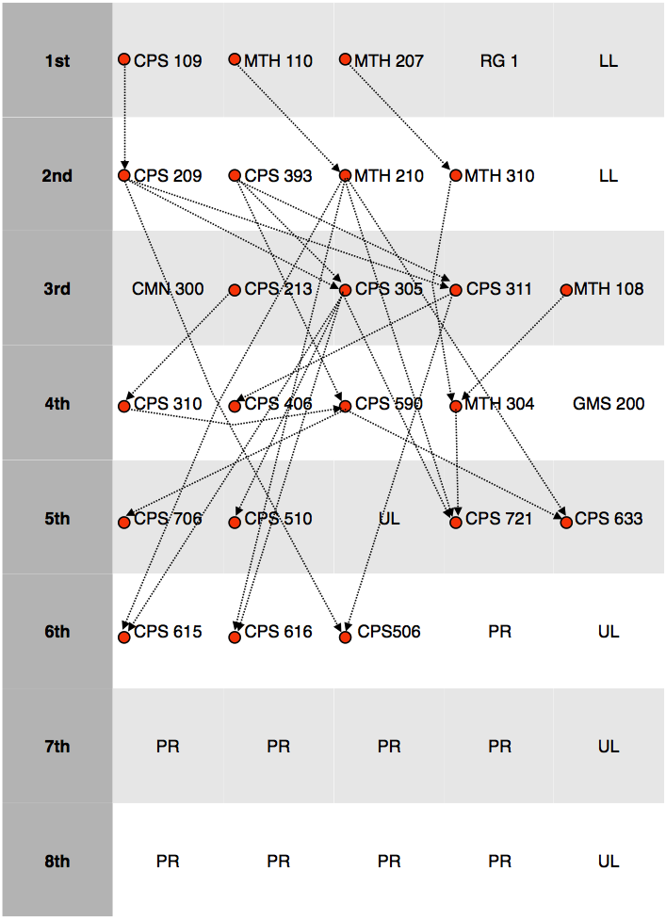
Academic Matters: course prerequisites

Slide 7
Academic Matters (cont.)
Course Intentions
Enrollment and timetable, when to get assistance
Course substitutions
Chang School courses
Lab exemptions
Course conflicts
Course Management Forms

Slide 8
Academic Matters: the co-op program
Admission requirements
Course work
The Co-op Office
Job placements
Graduation requirements

Slide 9
Student Services & Resources
Library, Brian Cameron
Student Learning Centre, John Hanna
Connections with self, others & your future
  Counsellor, David Moulton

Slide 10
Social and Organizational Student Activities
Student Union, Steven and Greg
Dept. Council Committee Representative Opportunities
Quick tour of facilities, then pizza, games and fun at Gould Street.

